Slide 1
Unaccompanied Immigrant Kids and Central American Migrants
Lauren R. Aronson MIGRATION GAME
Associate Clinical Professor DESIGN WORKING
Director, Immigration Law Clinic GROUP
University of Illinois College of Law October 2, 2019

Slide 2
Quick Overview
Terminology
Unaccompanied kiddos
  Who and how many?
Central American Migrants
  Numbers
Why do they come?
How do they get here?
Who’s missing?
What real options do they have for relief?

Slide 3
A couple of notes on terminology
Undocumented vs. unauthorized vs. illegal
“Alien”
Migrant vs. immigrant

Slide 4
Unaccompanied Alien Child (UAC)
“the term ‘unaccompanied alien child’ means a child who-
  Has no lawful immigration status in the United States;
  Has not attained 18 years of age; and
  With respect to whom-
    There is no parent or legal guardian in the United States; or
    No parent or legal guardian in the United States is available to provide care and physical custody.”
Homeland Security Act, 2002 6 USC § 279(g)(2)

Slide 5
UAC Southwest Border Apprehensions by Country
Country | FY 2014 | FY 2015 | FY 2016 | FY 2017 | FY 2018 | FY 2019 TD Aug
El Salvador | 16,404 | 9,389 | 17,512 | 9,143 | 4,949 | 11,593
Guatemala | 17,057 | 13,589 | 18,913 | 14,827 | 22,327 | 29,602
Honduras | 18,244 | 5,409 | 10,468 | 7,784 | 10,913 | 19,696
Other | 16,836 | 11,583 | 12,799 | 9,681 | 11,847 | 11,982
TOTAL | 68,541 | 39,970 | 59,692 | 41,435 | 50,036 | 72,873

Slide 6
Adult and Family Southwest Border Apprehensions by Country
Country | FY 2016 | FY 2017 | FY 2018 | FY 2019 TD Aug
El Salvador | 54,336 | 40,617 | 26,420 | 74,719
Guatemala | 55,688 | 51,044 | 93,395 | 229,033
Honduras | 42,484 | 39476 | 65,600 | 225,232
Other |  |  |  | 209,159
TOTAL |  |  |  | 738,143

Slide 7
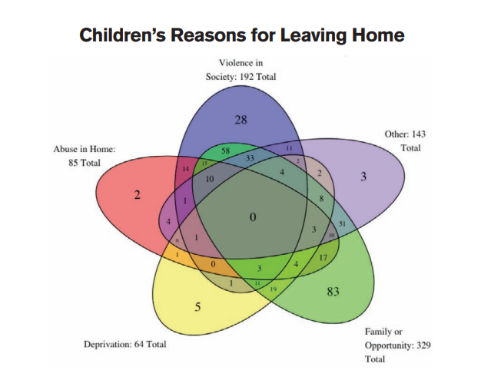




Why?

Slide 8
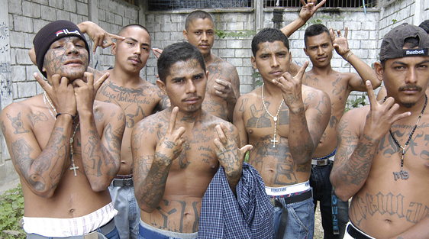
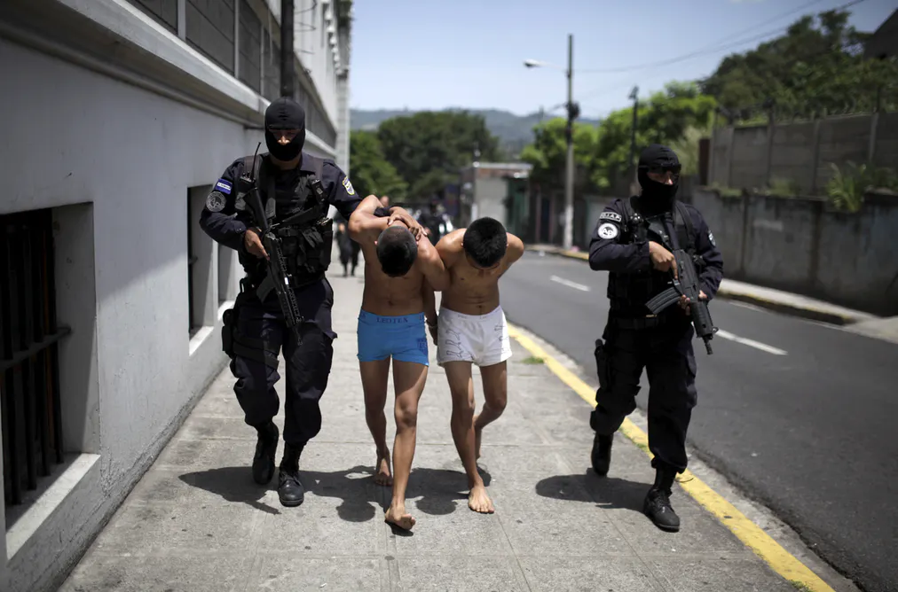
Violence and failure of state protection

Slide 9
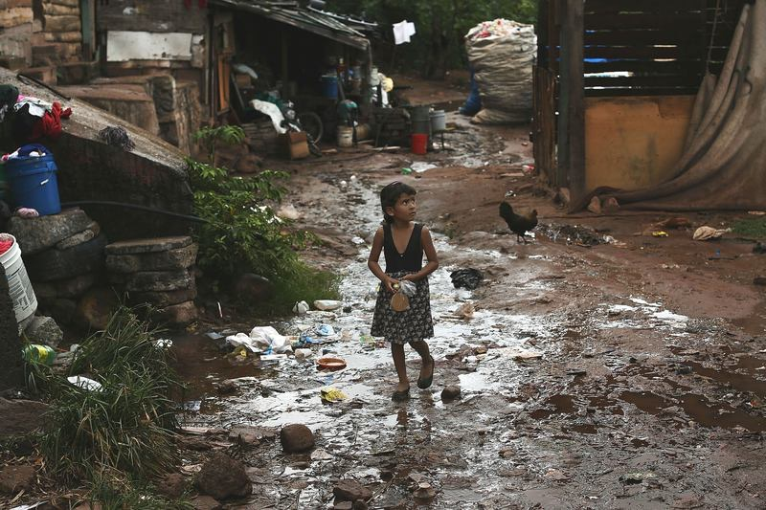

Family reunification and poverty or economic opportunity

Slide 10
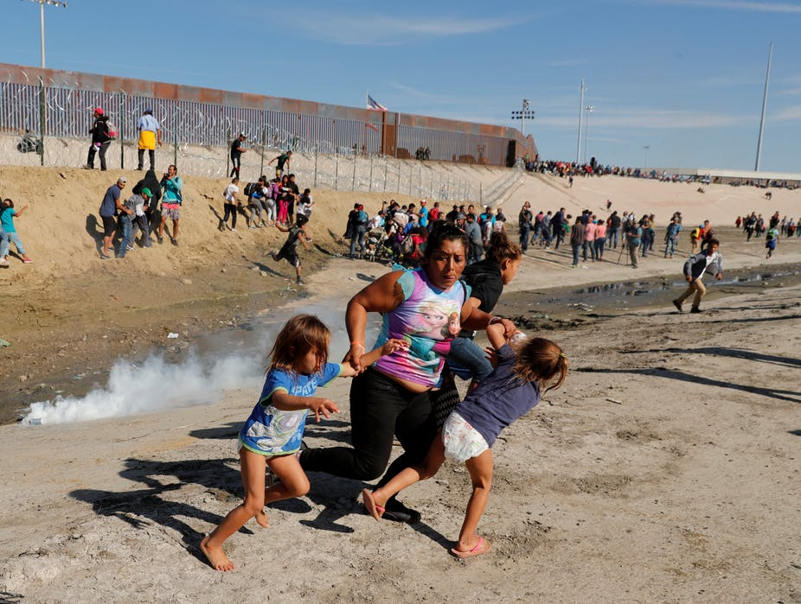
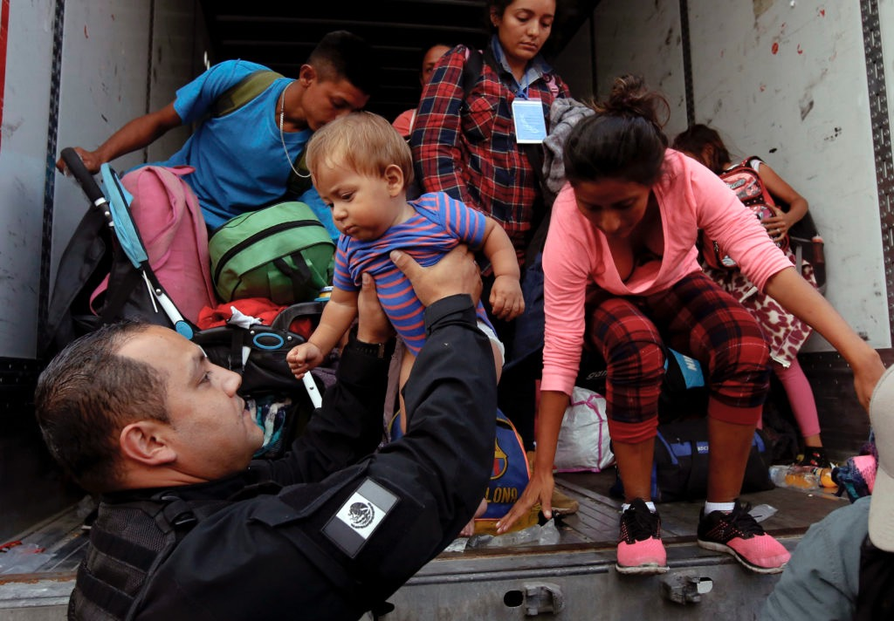
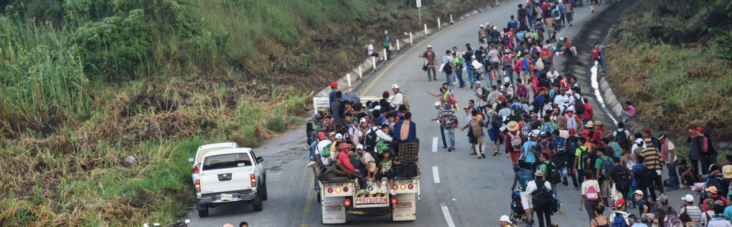
How do they get here?
By foot
By bus
By car/truck/hitchhiking
Coyotes/smugglers
By raft
By train

Slide 11
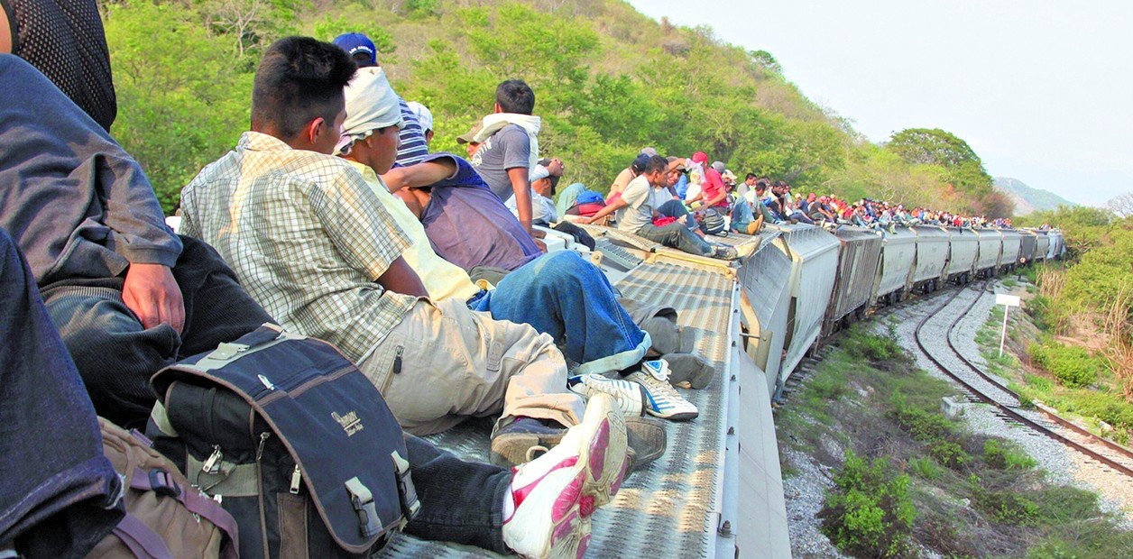
La Bestia – the Beast

Slide 12
Unauthorized Immigrants in the United States
No current lawful immigration status: between 11 and 22 million
  Might have crossed the border without inspection
  Might have entered with a visa that has expired
Numbers: Entered Without Inspection (55%); Overstayed a Visa (45%)
Could be or become eligible for lawful status

Slide 13
Now what? Removal Proceedings
Adults
  Expedited removal/voluntary return
  Detention - removal proceedings
  Catch and release - removal proceedings
Family units
  Detention - removal proceedings
  Release - removal proceedings
UACs
  Detention
  Release - removal proceedings

Slide 14
No right to counsel
The Immigration and Nationality Act provides that in proceedings, “the alien shall have the privilege of being represented, at no expense to the Government . . .”
63% of immigrants generally are NOT represented in immigration court.
  Family units or women and children are 14x more likely to be allowed to remain with counsel.

Slide 15
No Right to Counsel
Over 85% of detained immigrants are NOT represented by a lawyer during removal proceedings.
  Detained adults are 2x more likely to be allowed to remain.
Over 50% of UACs are NOT represented by a lawyer during removal proceedings.
  47% of UACs with representation allowed to remain
  10% of unrepresented UACs allowed to remain

Slide 16
Options for Acquiring Authorization
The reality is that options for this group are few
  Asylum/Withholding/CAT
  T-visa or U-visa (unusual)
Options are similarly limited for kiddos
  Special Immigrant Juvenile Status

